Slide 1
Agenda November 1st
Recap of Lecture 1 exercises
Installation
DLMtool manuscript
Online demo
L2a: Getting started
L2b: A simple run of DLMtool
L2c: Modifying operating models

Slide 2




Data-Limited Methods Toolkit
Evaluating management strategies for data-limited fish species
Exercise 1 Recap
Nov 1st 2017
Tom Carruthers & Adrian Hordyk .

Slide 3
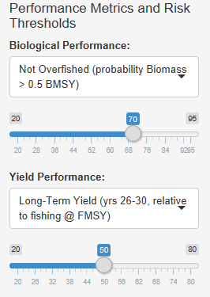
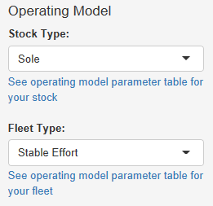
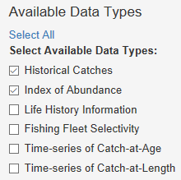
Scenario 1

Slide 4
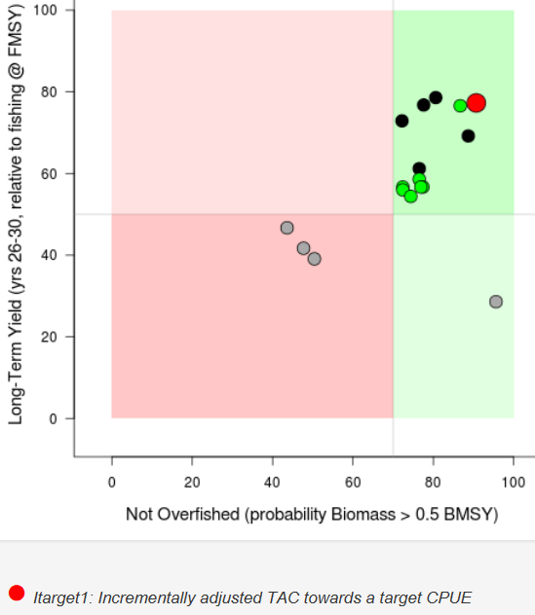
Identify a Management Procedure from the Trade-Off plot that you think is the best candidate for managing the fishery. Why do you think this is the best available method?

Slide 5
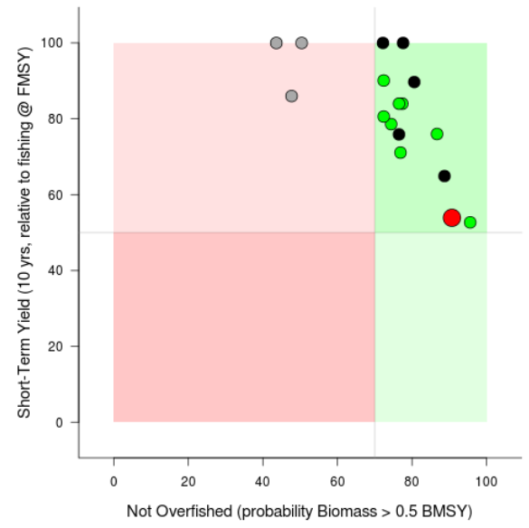
Short term vs long term yield
Itarget1: Incrementally adjusted TAC towards a target CPUE

Slide 6
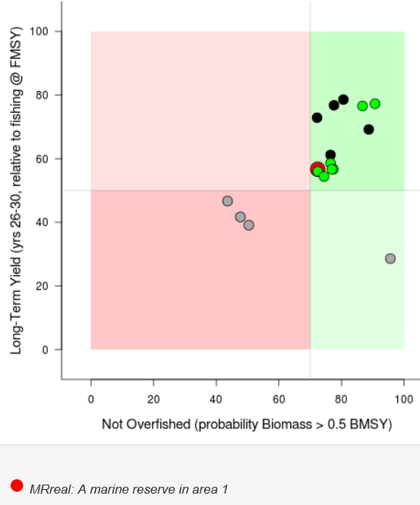
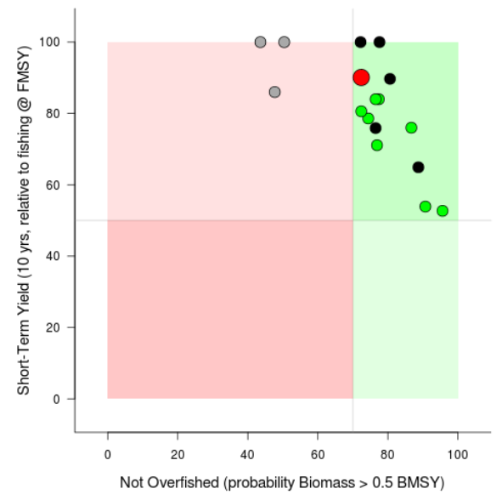
Short term vs long term yield
MRreal: A marine reserve in area 1

Slide 7
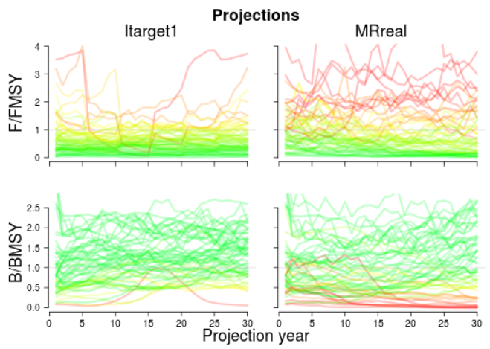

Slide 8
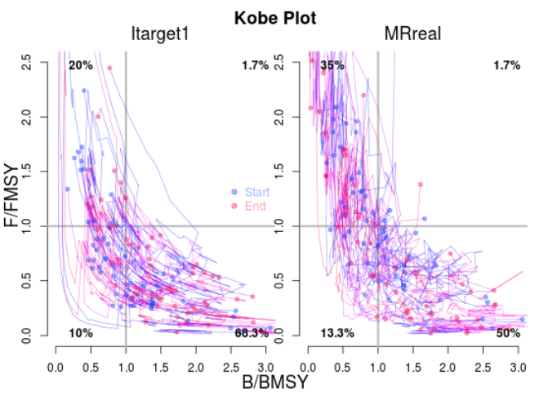

Slide 9
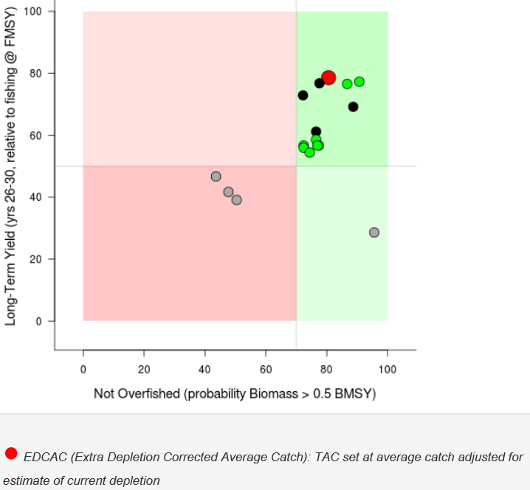
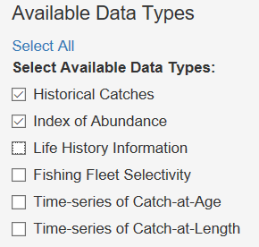
My ‘best’ method

Slide 10
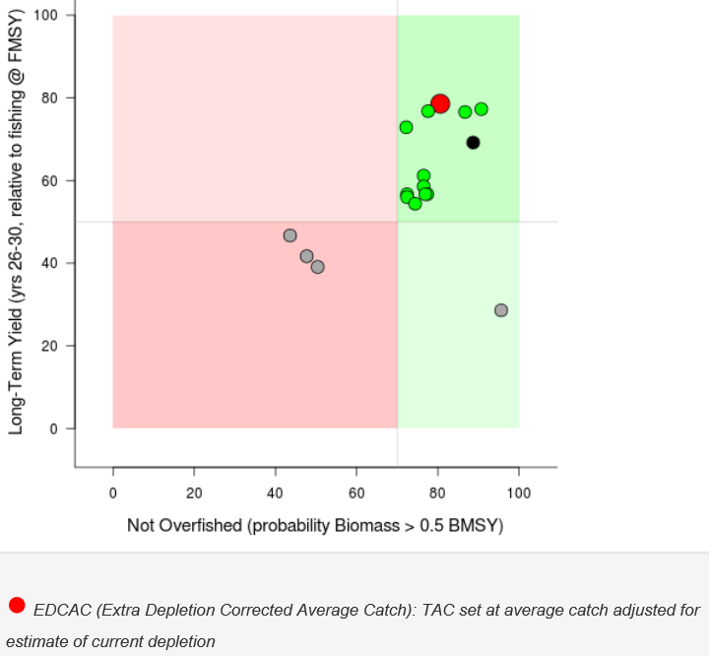
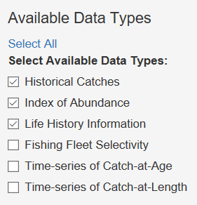
My ‘best’ method

Slide 11
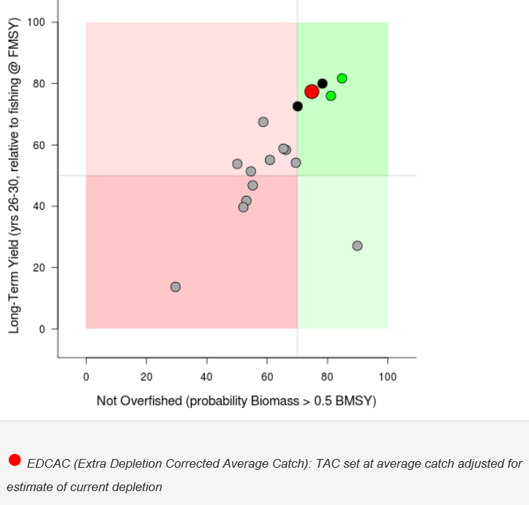
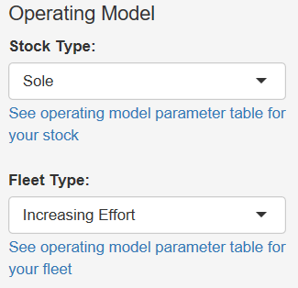

Slide 12
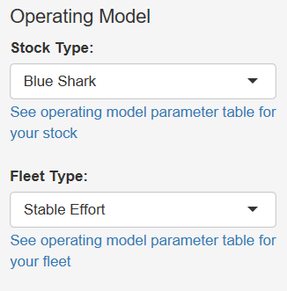
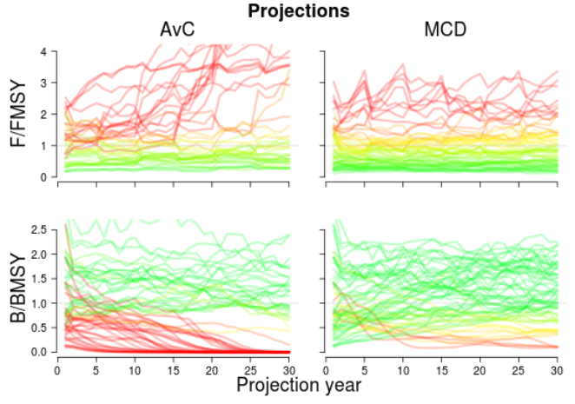
Scenario 2

Slide 13
Scenario 2

Slide 14
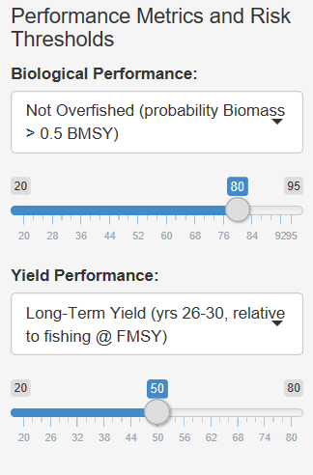
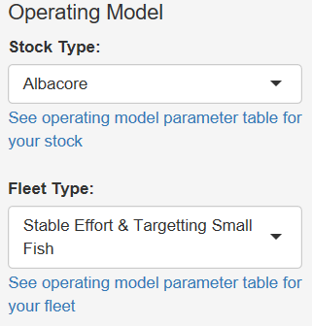
Scenario 3

Slide 15


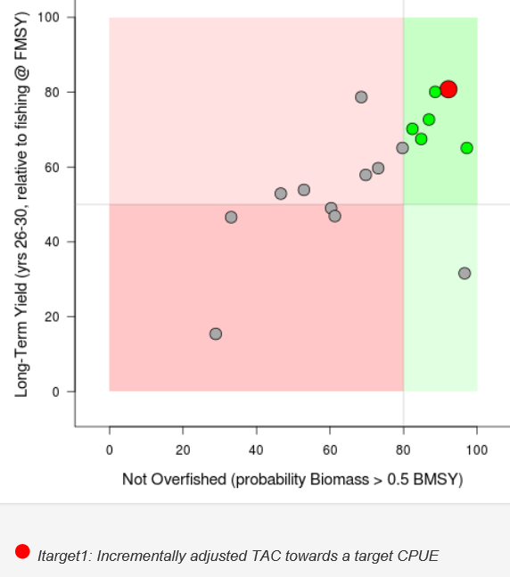
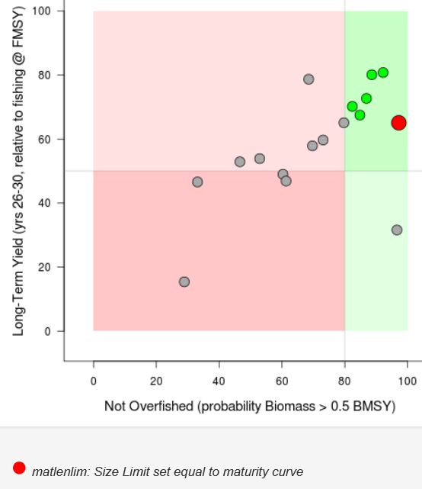
Itarget1: Incrementally adjusted TAC towards a target CPUE
matlenlim: Size Limit set to maturity curve

Slide 16
Itarget1
Proportional index
Historical perspective on index
Stationarity in population dynamics
Robust to implementation error
matlenlim
Dead discarding insignificant (probably necessary)
Size limit is enforceable

Slide 17
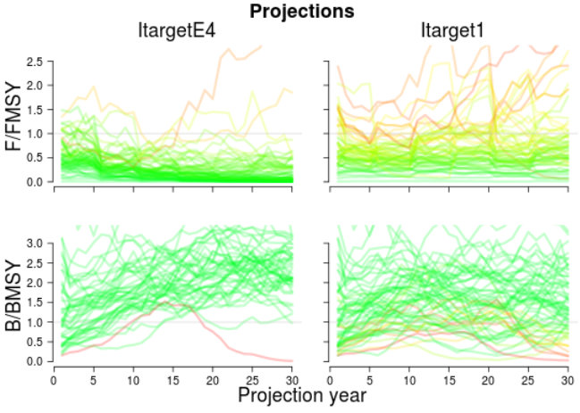
ItargetE4 chronically underfishes

